Slide 1
Autodiff and Optimizers
Prace2022 HPML

Slide 2
Autodiff
(a.k.a. Computational graphs)

Slide 3
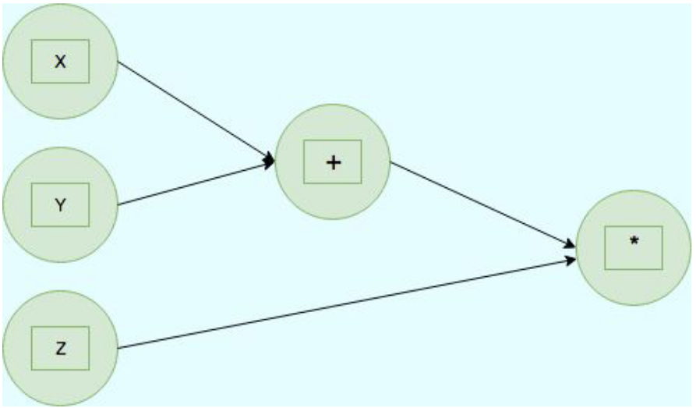
Computational Graphs
Represents math in graph format
Nodes and edges

Slide 4
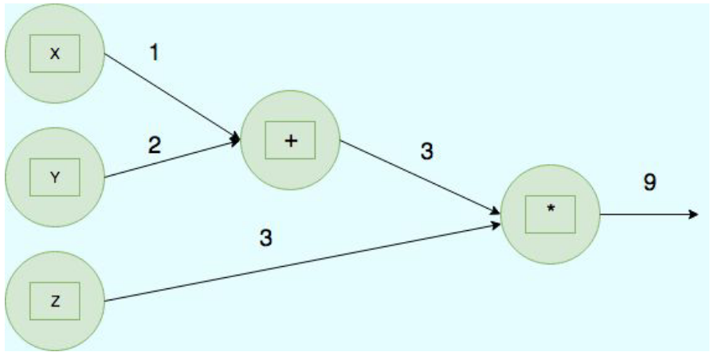
Computational Graphs
Represents math in graph format
Nodes and edges

Slide 5
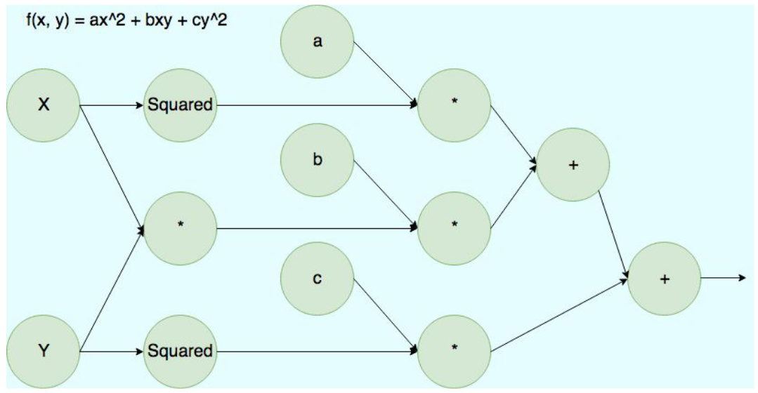

Slide 6
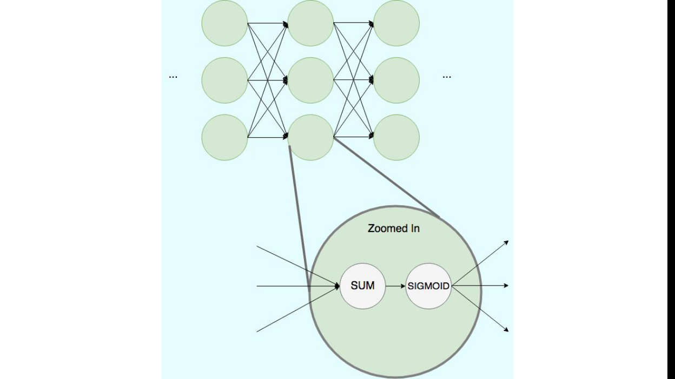

Slide 7
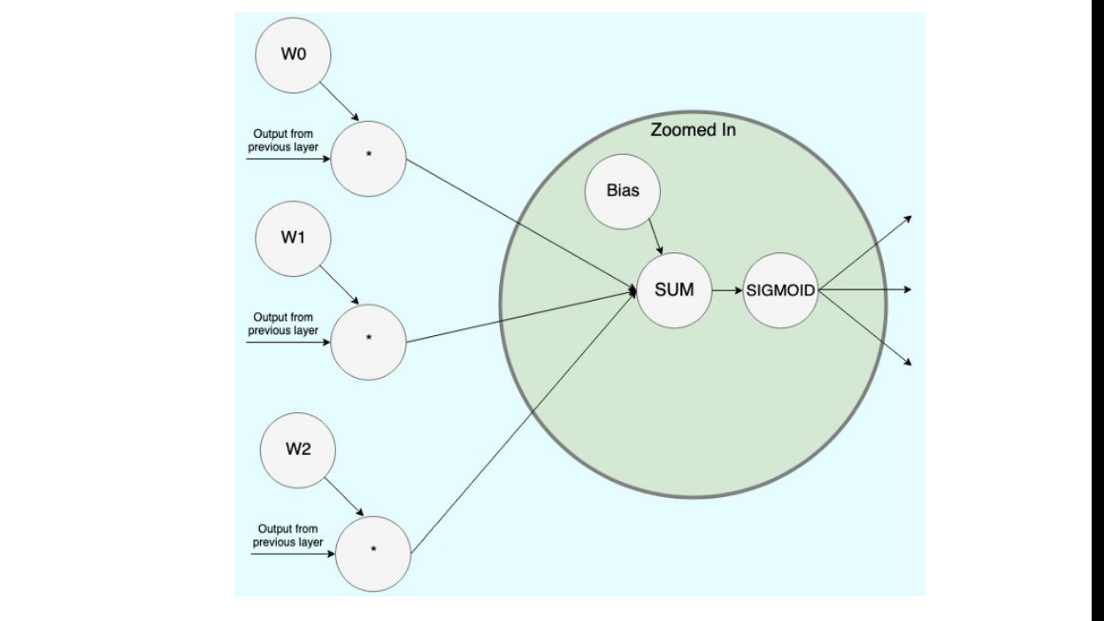

Slide 9
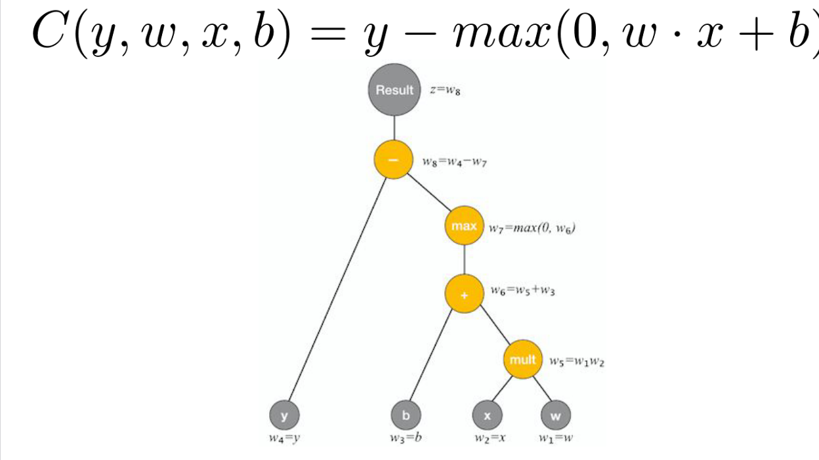

Slide 10
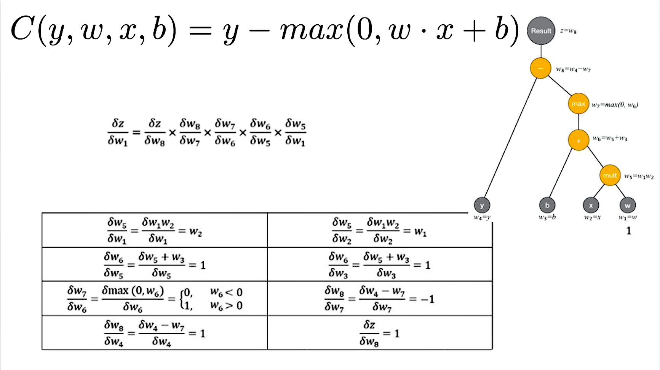

Slide 11
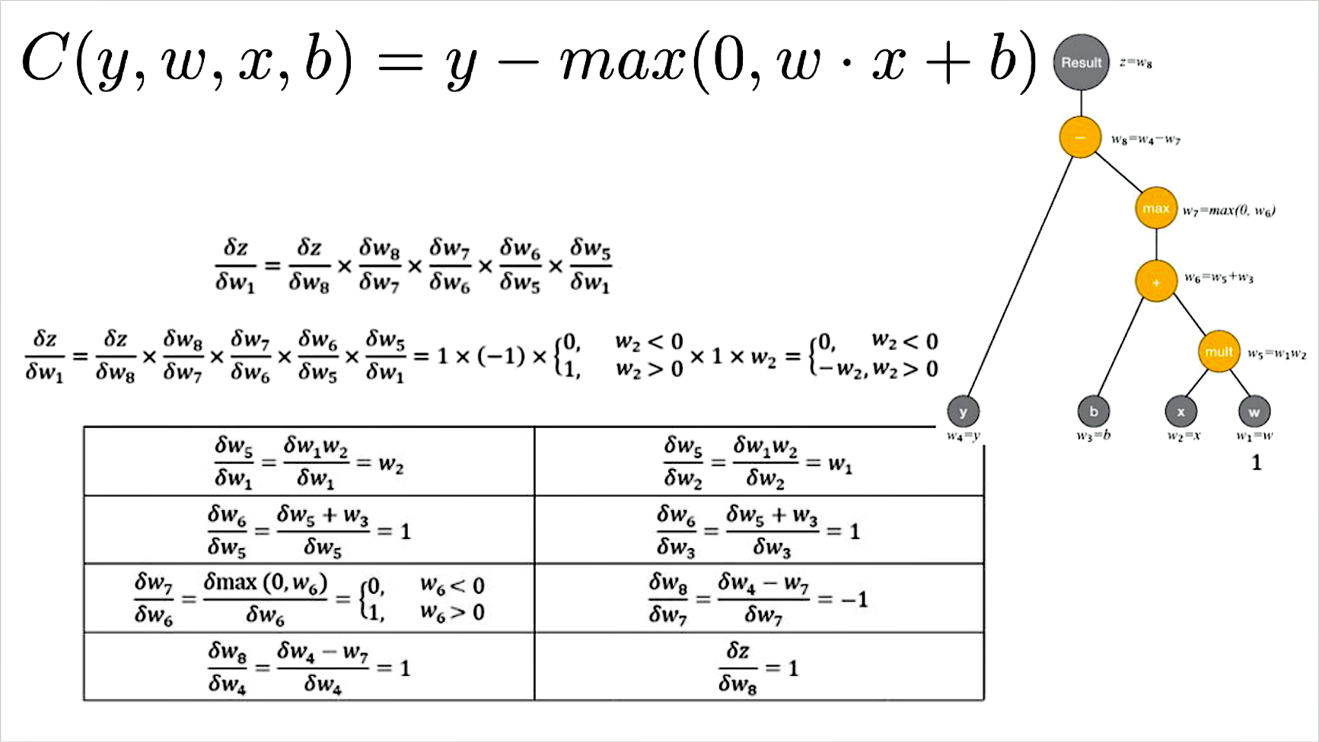

Slide 12
What do we need to save in the forward pass?

Slide 13
What do we need to save in the forward pass?
requires_grad=False
requires_grad=False

Slide 14
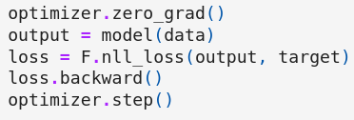
PyTorch workflow
Reset buffers (i.e. w.grad=0)
Create computational graph & store activations
Calculate actual gradients (i.e. w.grad=dL/dw)
Update parameters

Slide 15
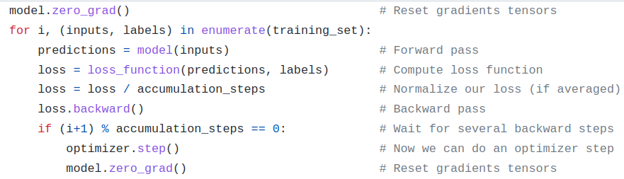
Leveraging internals for our gain

Slide 16
Optimizers

Slide 17
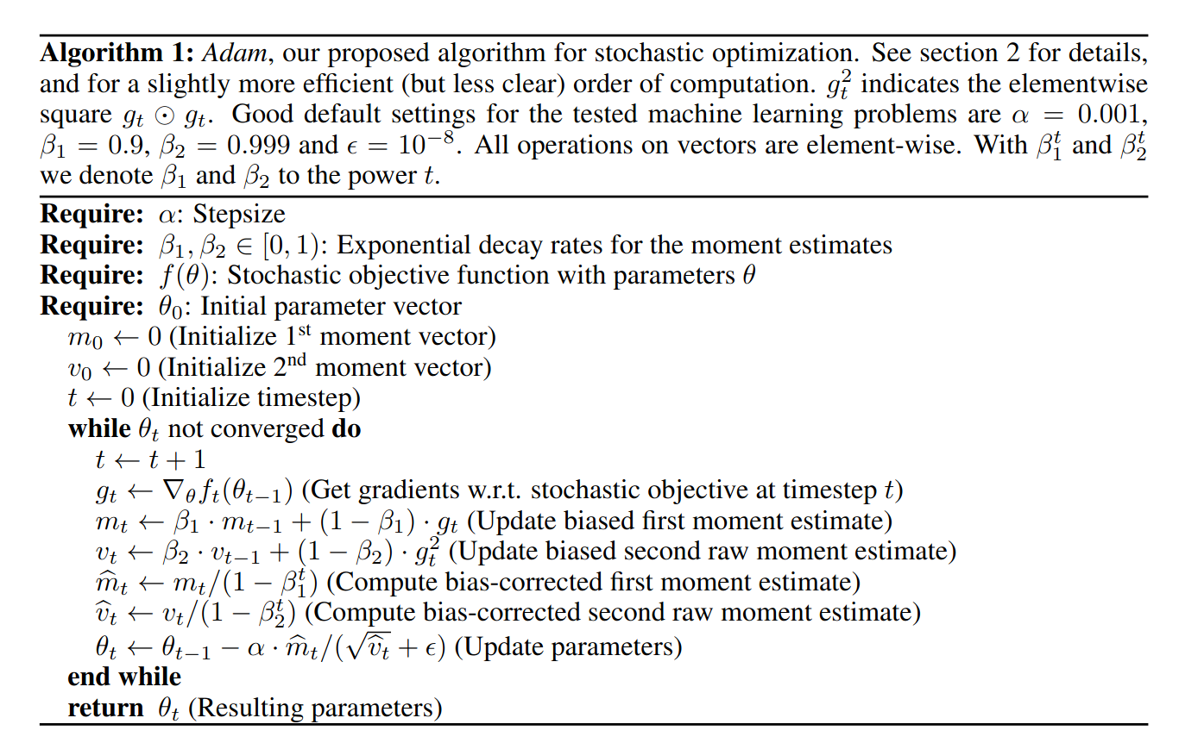
ADAM

Slide 18
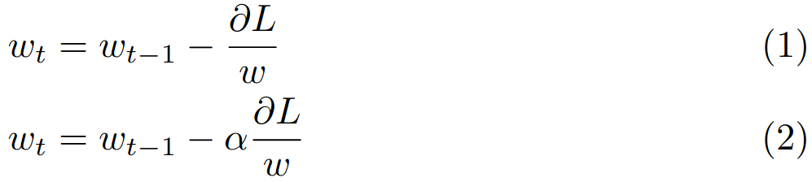
Let’s build our own optimizer

Slide 19


Slide 20
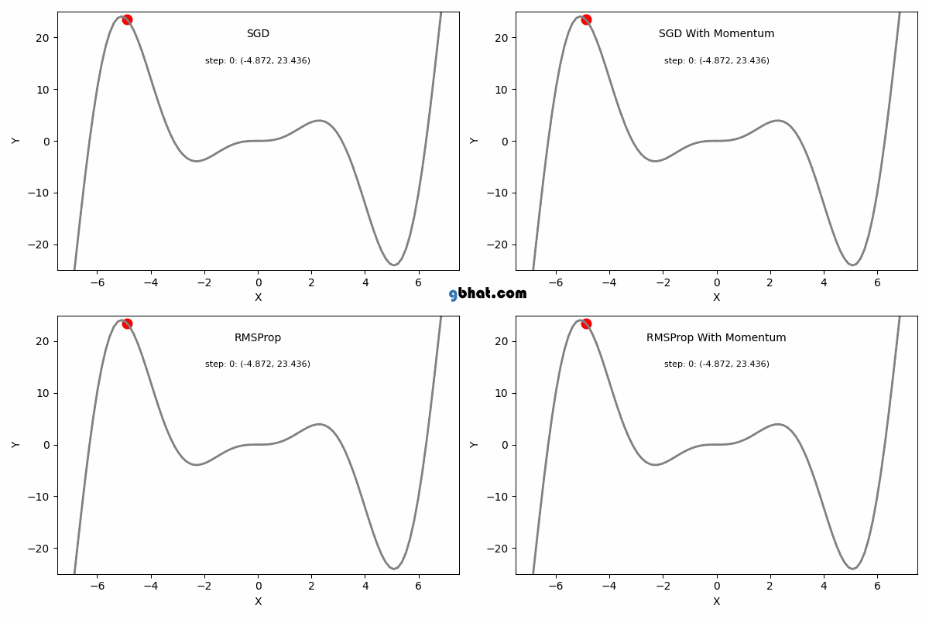

Slide 21
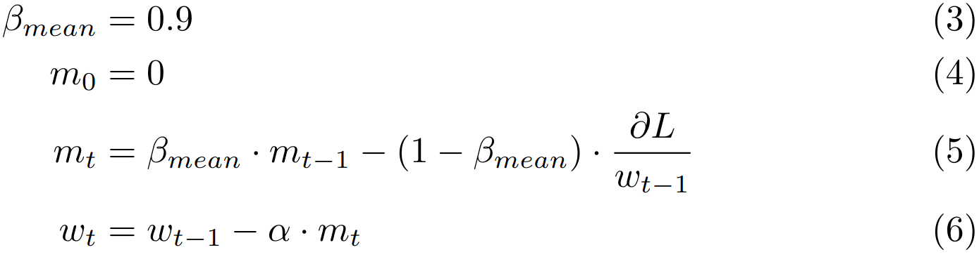
Adding momentum

Slide 22
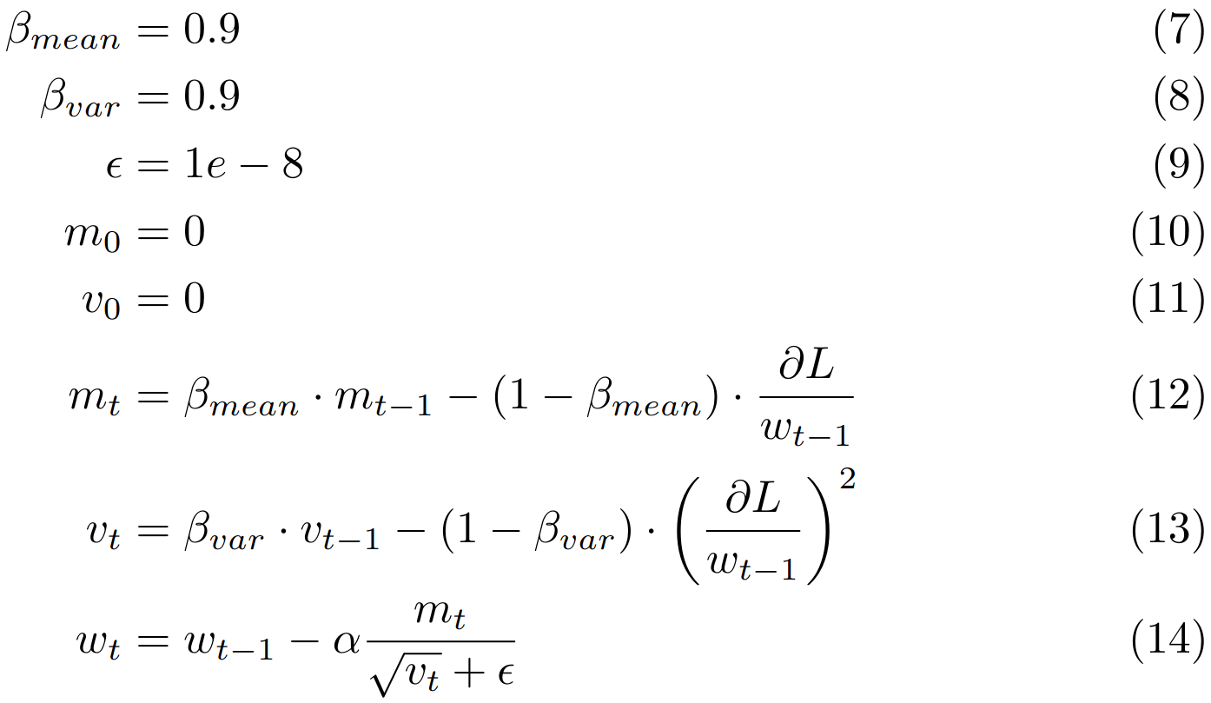
Adding normalisation

Slide 23
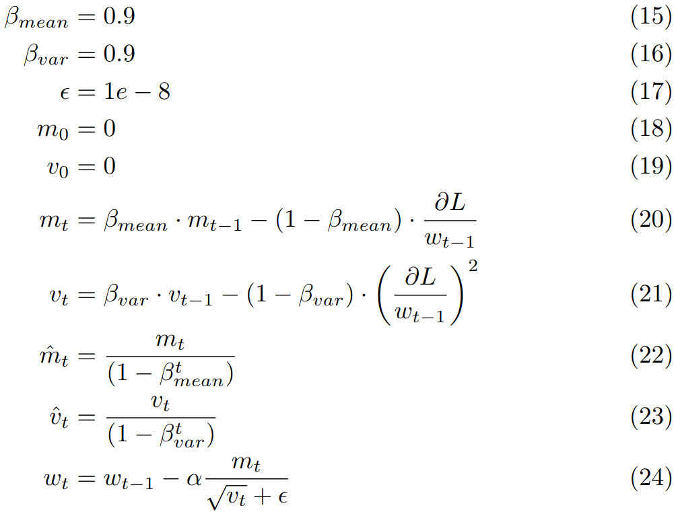
Removing bias towards 0

Slide 24
ADAM

Slide 25
What optimizer should I use?
(2014) SGD with nesterov momentum
(2018) Adam
(2022) AdamW + cosine annealed LR
(2026) ???

Slide 26
Fully-sharded data-parallel

Slide 27
What & Why
Models are way too big: 175B-1T parameters (325GB for only the parameters in FP16!)
Modern GPUs have ~40GB VRAM, Google TPUv4 32GB
Idea: Model parallelism & data parallelism at the same time
Shard model over workers & offload grads/params/etc to CPU RAM
Extends ‘DeepSpeed ZeRO’

Slide 28
3 options:
Shard optimizer state
Shard optimizer state + gradients
Shard optimizer state + gradients + parameters (+ activations?)
CPU offload?
Gradient checkpointing?

Slide 29
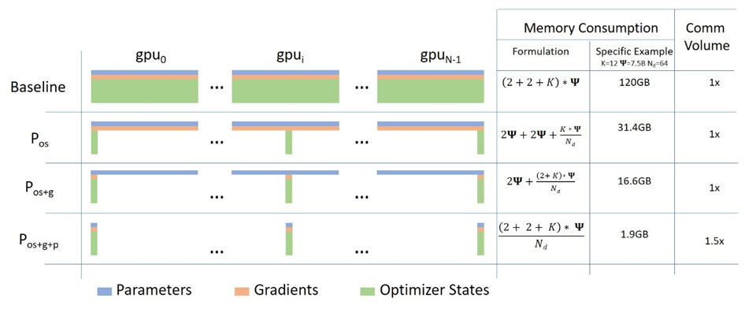
OS = Optimizer State Partitioning
G = Gradients
P = Parameters

Slide 30
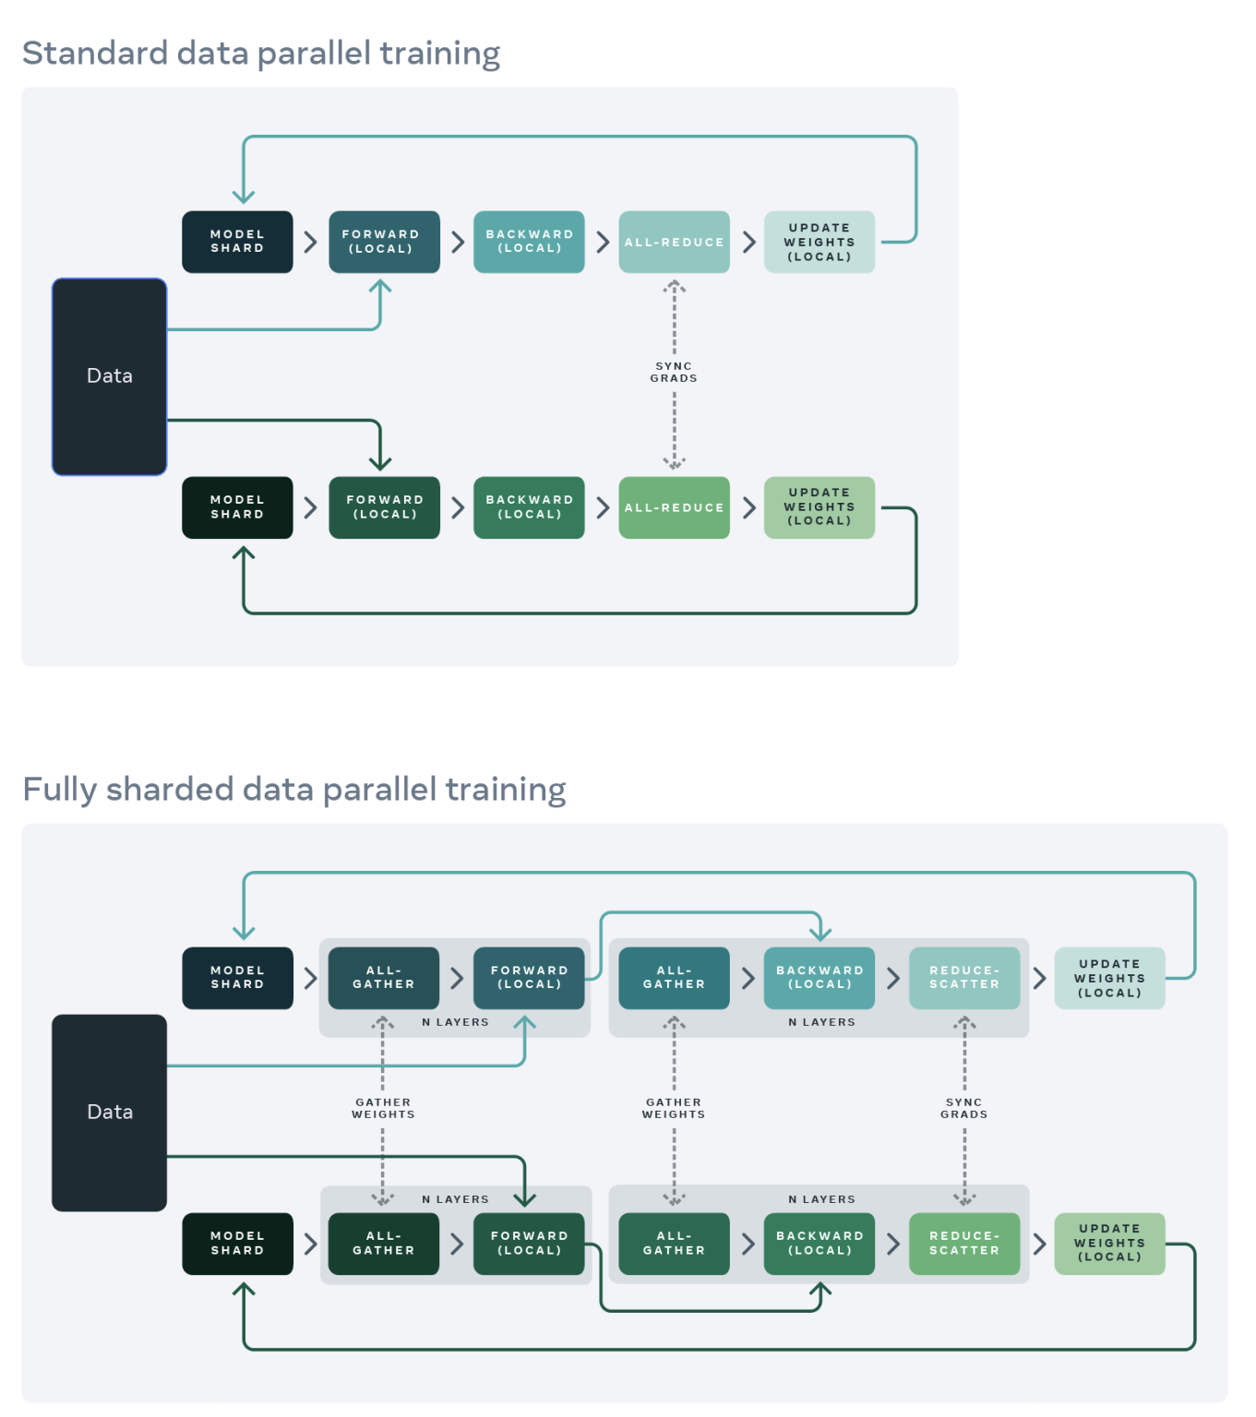
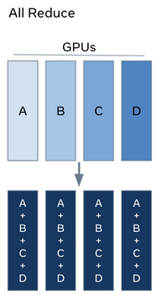

Slide 31
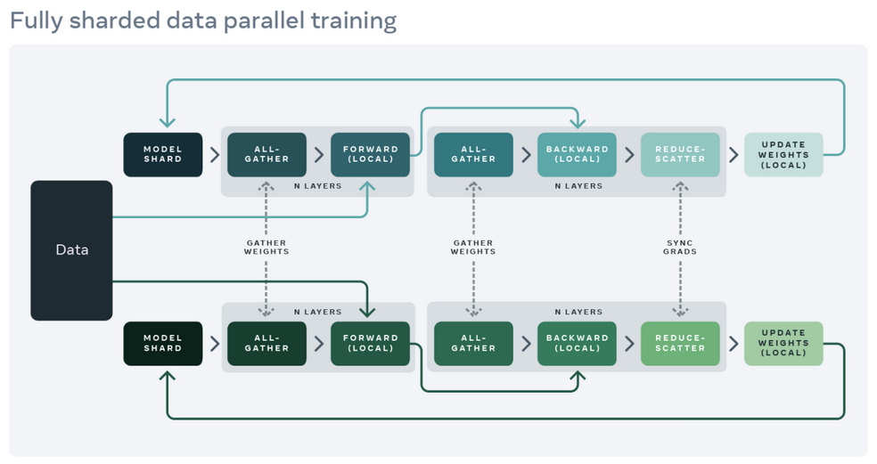
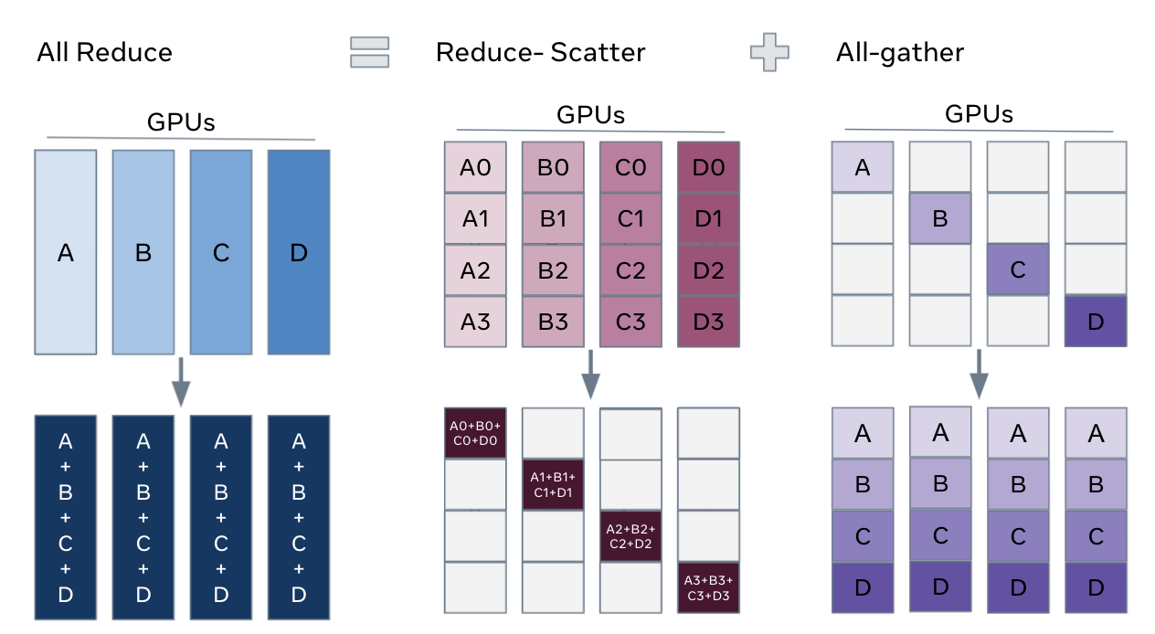
FSDP Workflow
In constructor - Shard model parameters and each rank only keeps its own shard
In forward path - Run all_gather to collect all shards from all ranks to recover the full parameter in this FSDP unit - Run forward computation - Discard parameter shards it has just collected
In backward path - Run all_gather to collect all shards from all ranks to recover the full parameter in this FSDP unit - Run backward computation - Run reduce_scatter to sync gradients - Discard parameters.

Slide 32
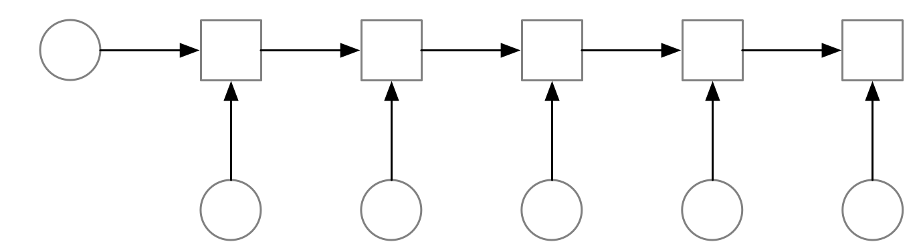
Gradient checkpointing

Slide 33
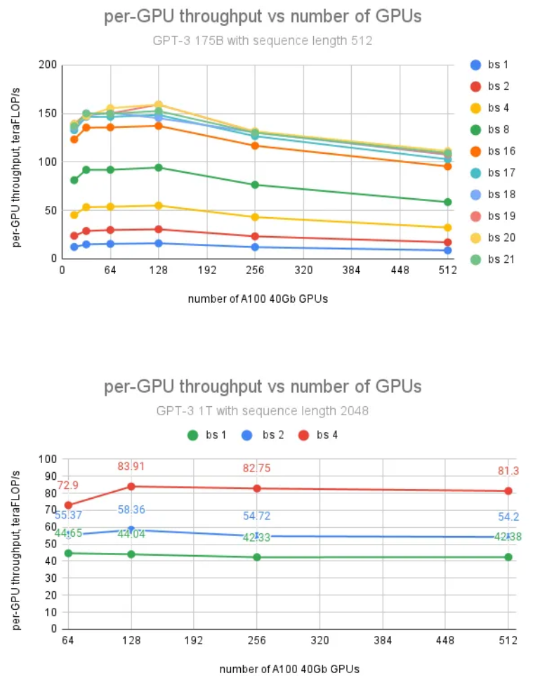
Throughput
175B: ~51% maximum per-gpu
1T: ~27% maximum per-gpu
One big optimization problem:
If there are too many shards, we’re wasting communication over computation
If the shards are too small, we’re inducing latency into the communication
Need to take into account the topology of the network
Need to take into account the memory size and theoretical throughput of our workers
Always limited by networking

Slide 34
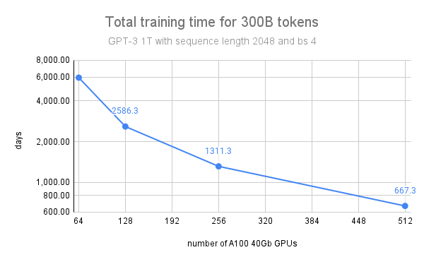
Throughput
175B: “Per our estimate, it would take 128 NVIDIA A100 40GB GPUs running for about 240 days to train GPT-3 175B using FSDP. According to current AWS public pricing, the strategy we would pick is to reserve 16 p4d.24xlarge instances for a duration of 1 year.”
1T: “Based on the total training time curve and current AWS pricing for 1 year and 3 years reservation, we suggest 2 possible strategies for training 1T GPT-like neural networks using PyTorch FSDP. Fast: 1-year training across 128 p4d.24xlarge instances, and Long: 3 years training across 43 p4d.24xlarge instances.”
https://medium.com/pytorch/training-a-1-trillion-parameter-model-with-pytorch-fully-sharded-data-parallel-on-aws-3ac13aa96cff

Slide 35
In the real world:

Slide 36
In the real world:
https://pytorch-lightning.readthedocs.io/en/stable/advanced/model_parallel.html
https://fairscale.readthedocs.io/en/stable/api/nn/fsdp.html

Slide 37
